Slide 1


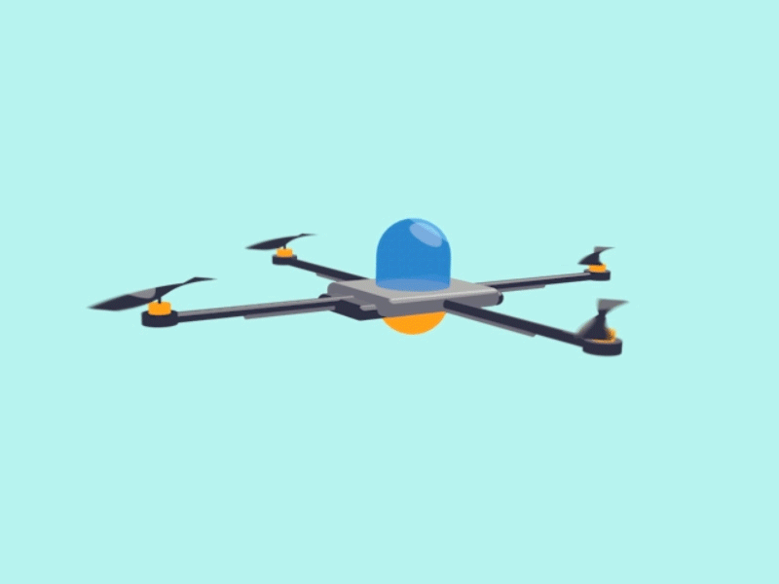
Honeywell Navigation challenge
Final proposal
Team members
Amaris Vélez
María De León
Mentor
Wenceslao López
EE 4022 -WI19
17-JAN-2019

Slide 2
Agenda
Define problem
State objective
Executed Work/Results
Future work

Slide 3
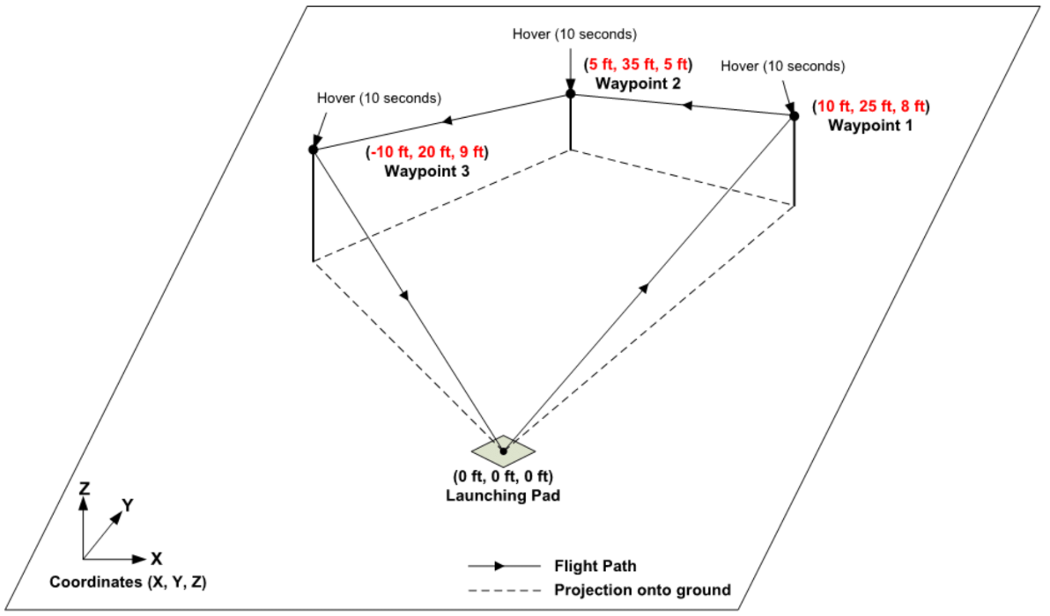
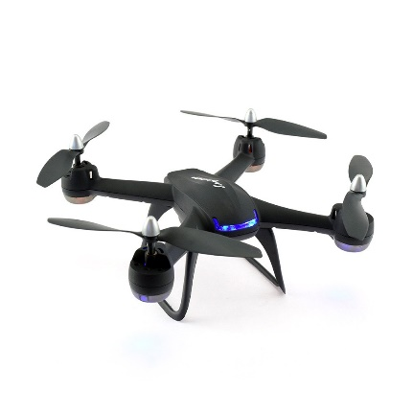
Problem

Slide 4
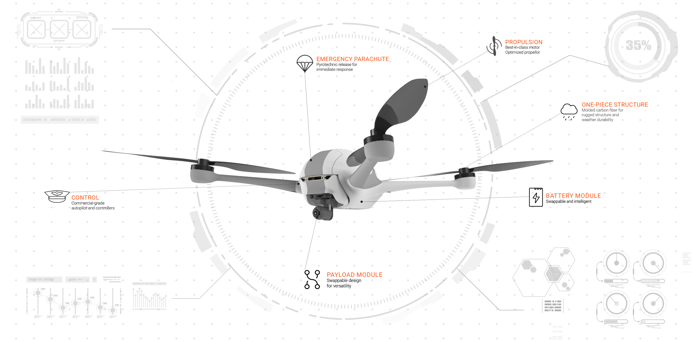

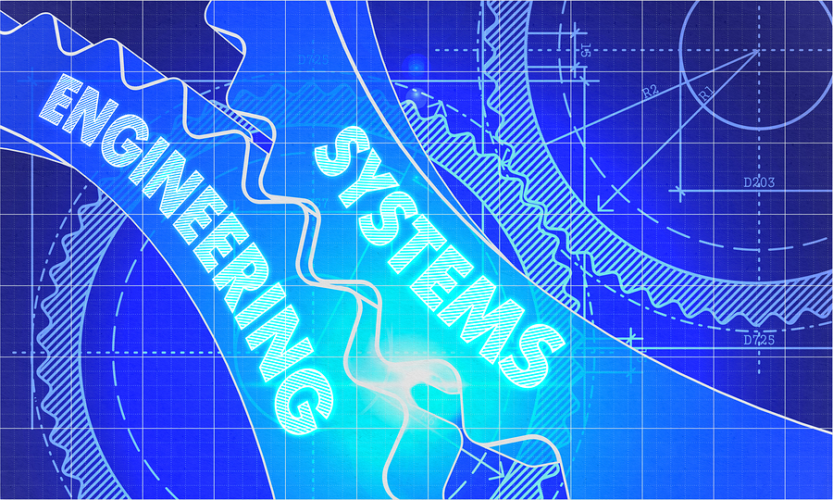
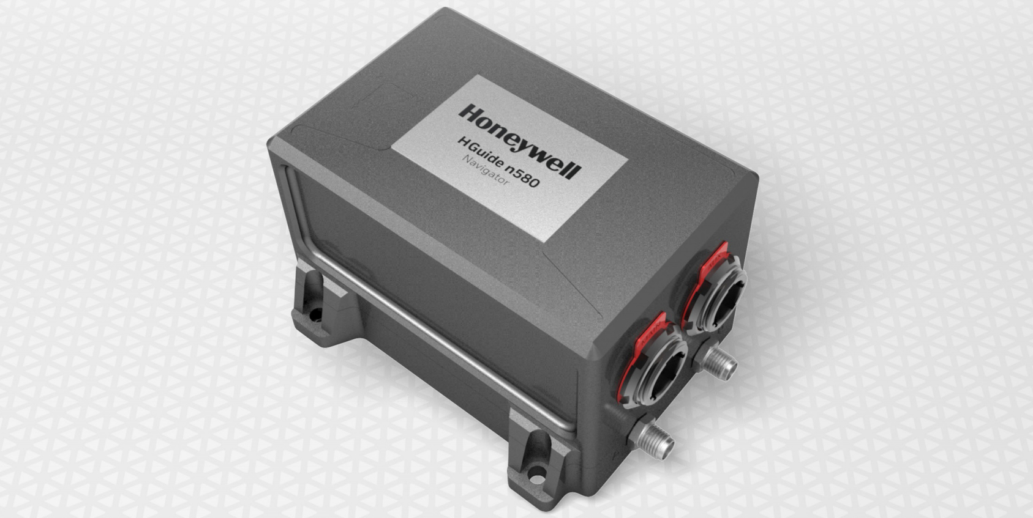
Objectives

Slide 5
Executed work
Revised Simulink control system model
Revised equations of motion
Revised equations for determining power supply
Established possible communication schemes
MATLAB-Arduino tests
Implementing I2C
Evaluated IMU/GPS substitutes

Slide 6
Results

Slide 7
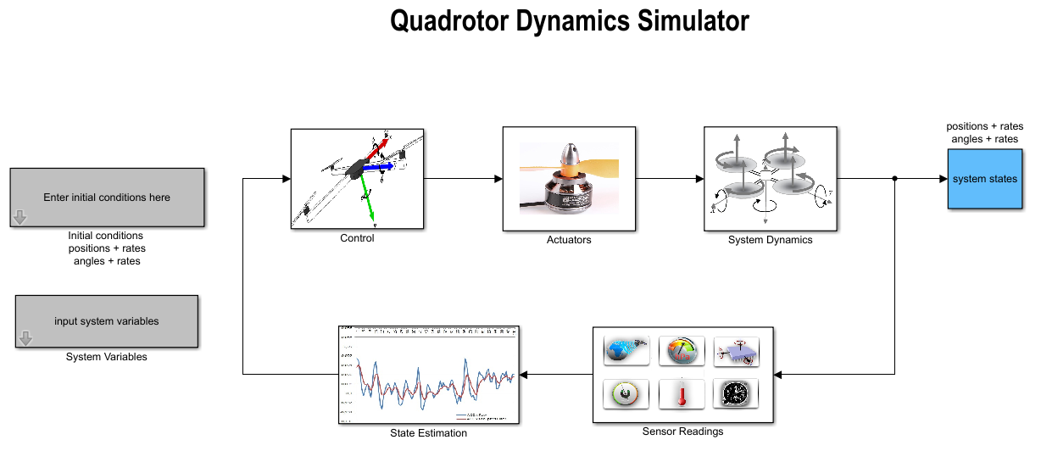
Simulink uav Model

Slide 8

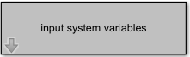
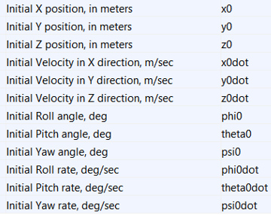
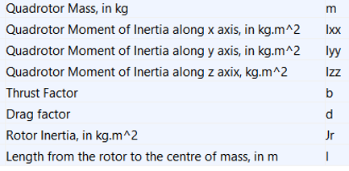
Simulink uav Model

Slide 9
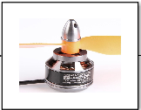
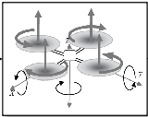
Simulink uav Model
System
States
Actuator
System Dynamics
Displacement
Angles
Motor voltage, drag
Moment of inertia
Other motor data
4 RPS variables from Actuator
System Variables
Quadrotor mass
Quadrotor moment of inertia
Rotor inertia
Thrust and drag factors
Initial Condition for:
Linear and angular positions
Linear and angular velocities

Slide 10
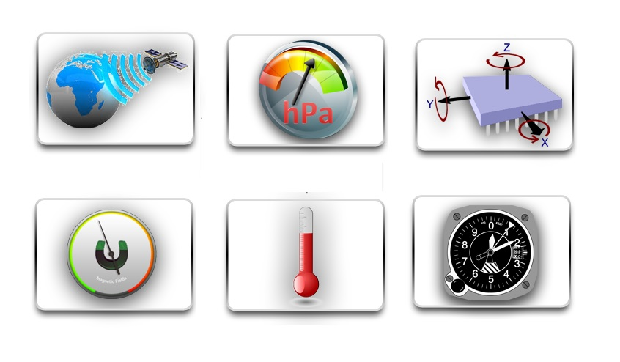
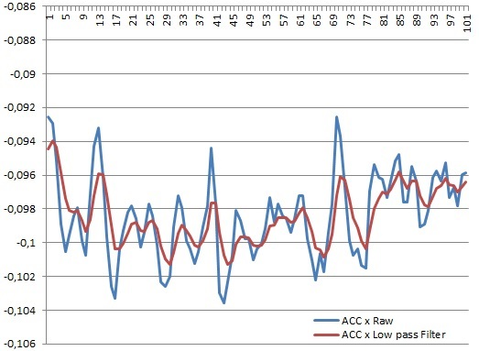
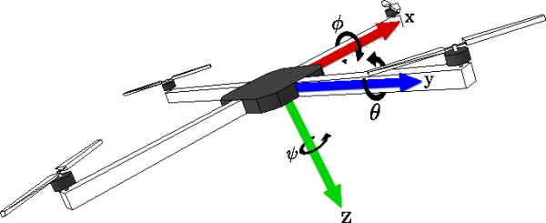
Simulink uav Model
Sensor Readings
State Estimation
Control
Gyro, etc..
Angular velocity (𝜙 θ ψ)
State variables data
Kalman filter
Voltage conversion
Linear and angular velocities
Linear and angular velocities
Voltage conversion

Slide 11
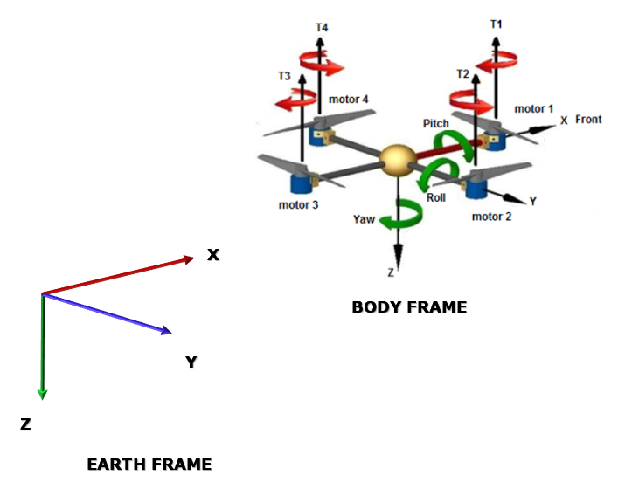
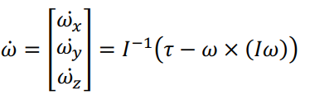
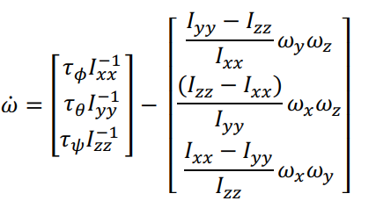
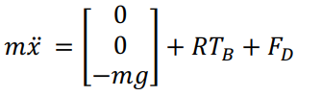
Equations: Motion
The rotational equations of motion are written in the Body frame are derived from Euler's equations for rigid body dynamics.
The acceleration of the quadcopter in the inertial (Earth) frame is due to thrust, gravity, and linear friction.
Notes:
Where x is the position of the quadcopter, g is the acceleration from gravity, FD is the drag force, and TB is the thrust vector in the body frame.
Where w is the angular velocity vector, I is the moment of inertia, and is a vector of external torques. To obtain I, the quadcopter is modeled as two thin uniform rods crossed at the origin with a point mass (motor) at the end of each rod.

Slide 12
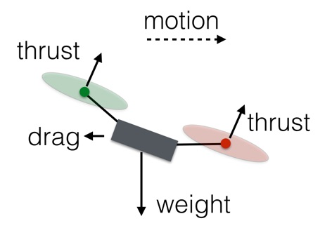
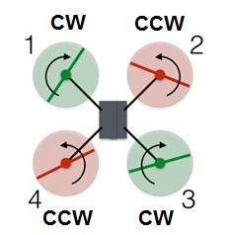
Equations: Motion
Movement by changing the spin rate of one or more rotors (the voltage to each motor)
Vertical : Hover, Climb and Descend
- For climbing, three forces on the drone takes place: weight, thrust and air drag
Horizontal: Forwards and Sideways
- Increase/decrease the rotation rate of rotors CW-CCW pairs
- Roll is making the quadcopter fly sideward, either to left or right.
- Pitch is the movement of quadcopter either forward or backward.
Rotation
- Increasing/decreasing the rotation rate of rotors CW-CW or CCW-CCW in opposite direction
(one pair is increased while the other is decreased)
- Rotation around the vertical axis is called yaw
Notes:
Drones use rotors for propulsion and control. Spinning blades push air down.
All forces come in pairs, which means that as the rotor pushes down on the air, the air pushes up on the rotor. This is the basic idea behind lift, which comes down to controlling the upward and downward force. The faster the rotors spin, the greater the lift, and vice-versa.
Vertical Motion: drone can do three things in the vertical plane:
Hover - the net thrust of the four rotors pushing the drone up must be equal to the gravitational force pulling it down
Climb - the thrust (speed) of the four rotors must be increased so that there is a non-zero upward force that is greater than the weight (three forces on the drone: weight, thrust, and air drag)
Descend - requires doing the exact opposite: Simply decrease the rotor thrust (speed) so the net force is downward
Horizontal motion: Forwards and Sideways
Increase the rotation rate of rotors 3 and 4 (the rear ones) and decrease the rate of rotors 1 and 2. The total thrust force will remain equal to the weight, so the drone will stay at the same vertical level. Also, since one of the rear rotors is spinning counterclockwise and the other clockwise, the increased rotation of those rotors will still produce zero angular momentum. The same applies to sideways by increasing the rotation rate of 1 and 4 or 2 and 3.
Turning (Rotating)
In this configuration, the red rotors are rotating counterclockwise and the green ones are rotating clockwise. With the two sets of rotors rotating in opposite directions, the total angular momentum is zero.
Decreasing the spin of rotor 1 did indeed cause the drone to rotate, but it also decreased the thrust from rotor 1. Now the net upward force does not equal the gravitational force, and the drone descends.
To rotate the drone without creating all those other problems, decrease the spin of rotor 1 and 3 and increase the spin for rotors 2 and 4. The angular momentum of the rotors still doesn't add up to zero, so the drone body must rotate. But the total force remains equal to the gravitational force and the drone continues to hover. Since the lower thrust rotors are diagonally opposite from each other, the drone can still stay balanced.
Every movement is accomplished by changing the spin rate of one or more rotors. Doing that simply requires a controller that can increase or decrease the voltage to each motor.
Movements can be controlled through adjustment of the rotational speed of the motors.
Roll
Rotation around the front-to-back axis is called roll. Roll is making the quadcopter fly sideward, either to left or right.
Pitch
Rotation around the side-to-side axis is called pitch. Pitch is the movement of quadcopter either forward or backward.
Yaw
Rotation around the vertical axis is called yaw. Yaw is the deviation/rotating the head of quadcopter either to right or left.

Slide 13
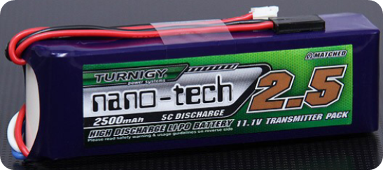
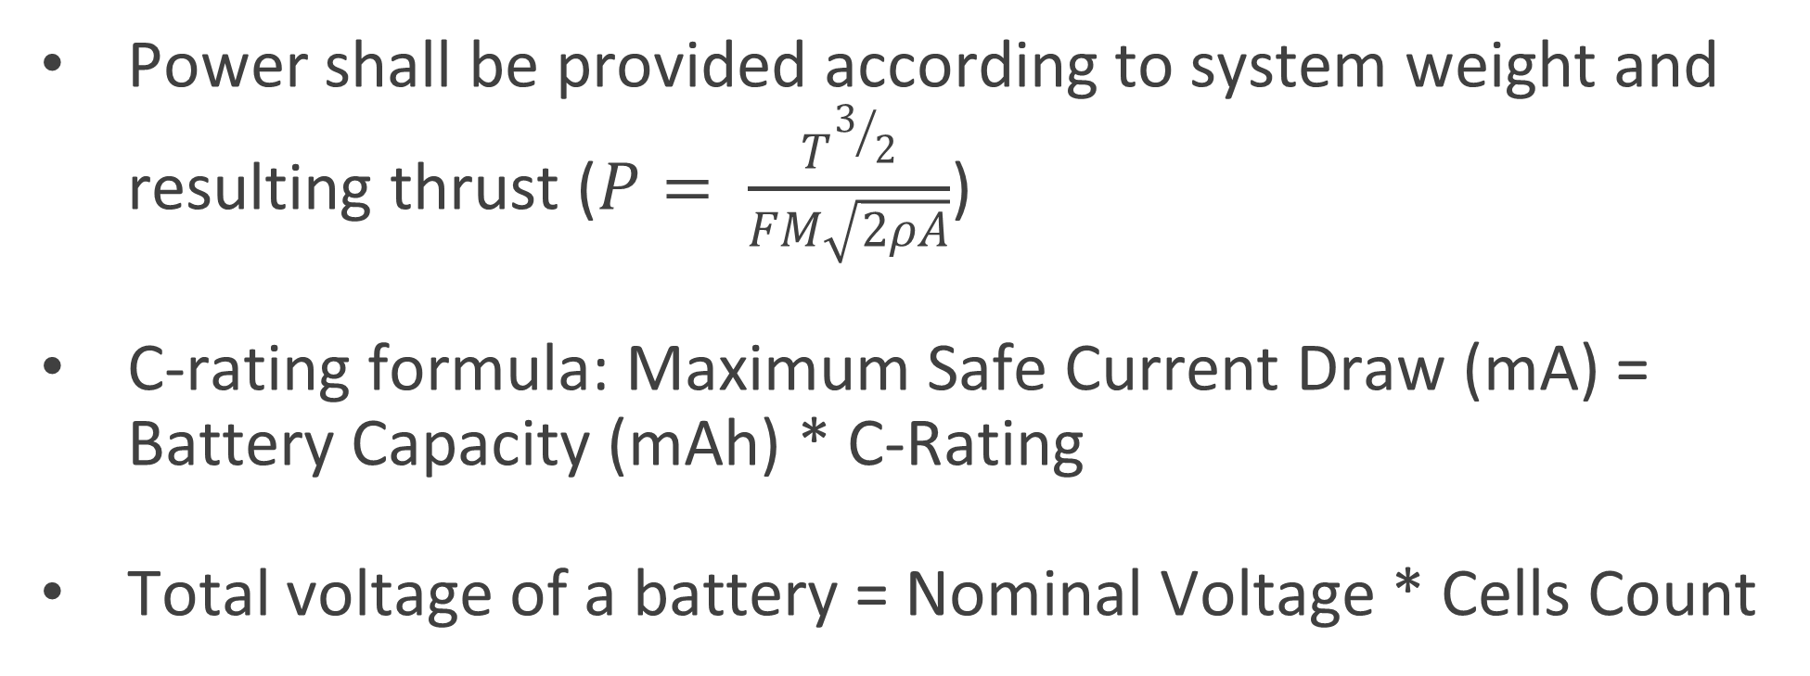
Equations: Power
Power shall be provided according to system weight and resulting thrust ($P= \frac{T^{3/2}}{FM\sqrt{2ρA}}$)
C-rating formula: Maximum Safe Current Draw (mA) = Battery Capacity (mAh) * C-Rating
Total voltage of a battery = Nominal Voltage * Cells Count

Slide 14
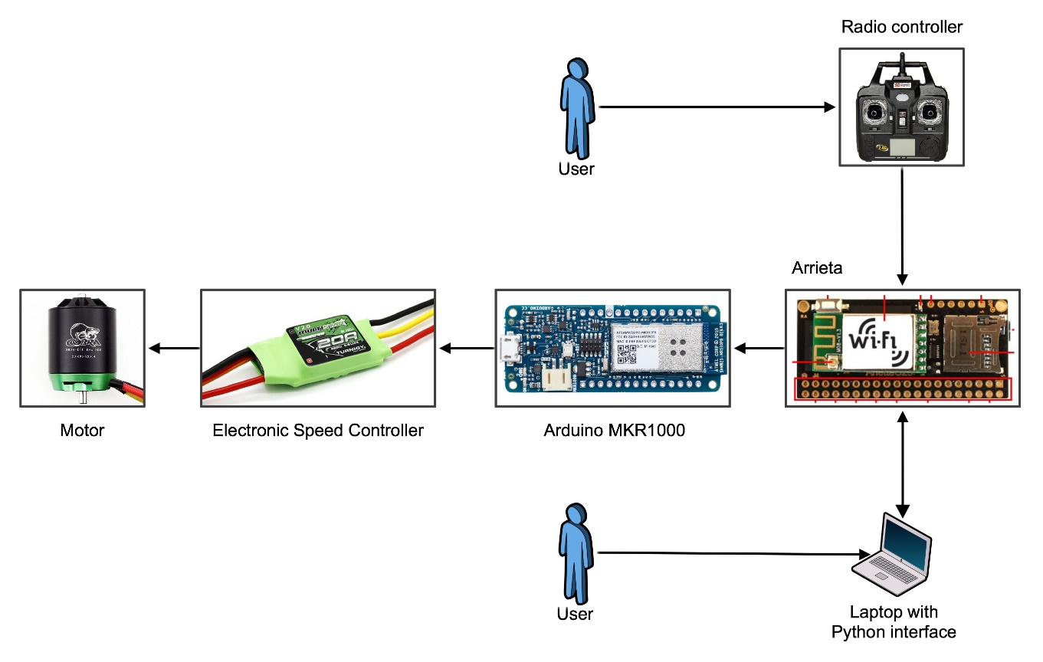
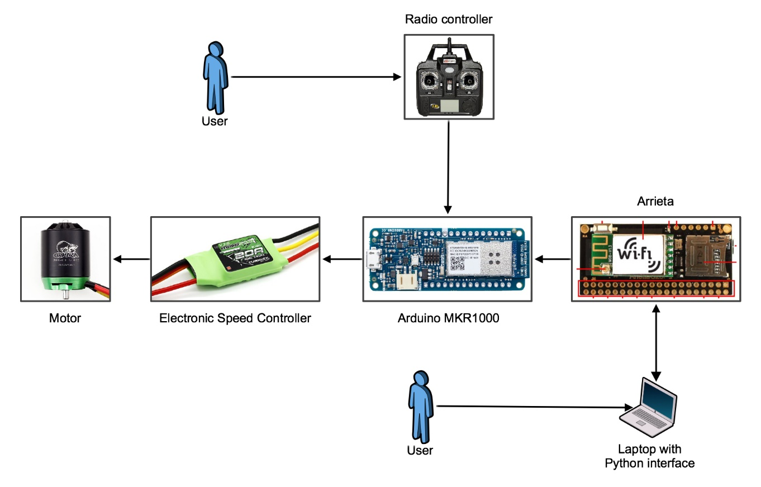
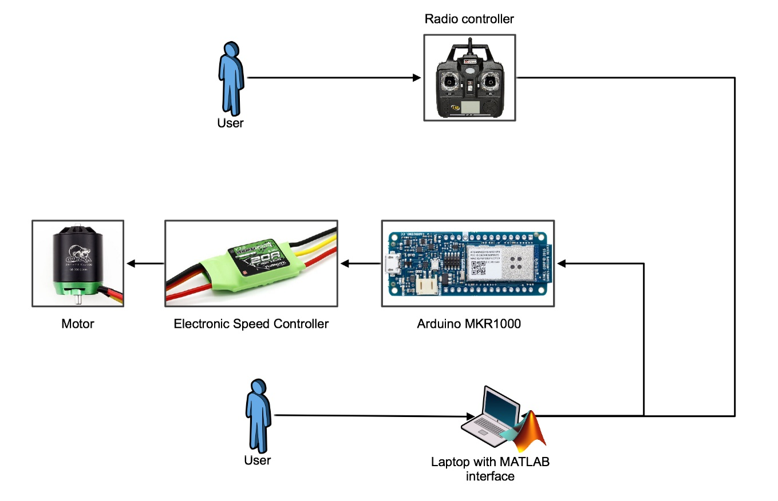
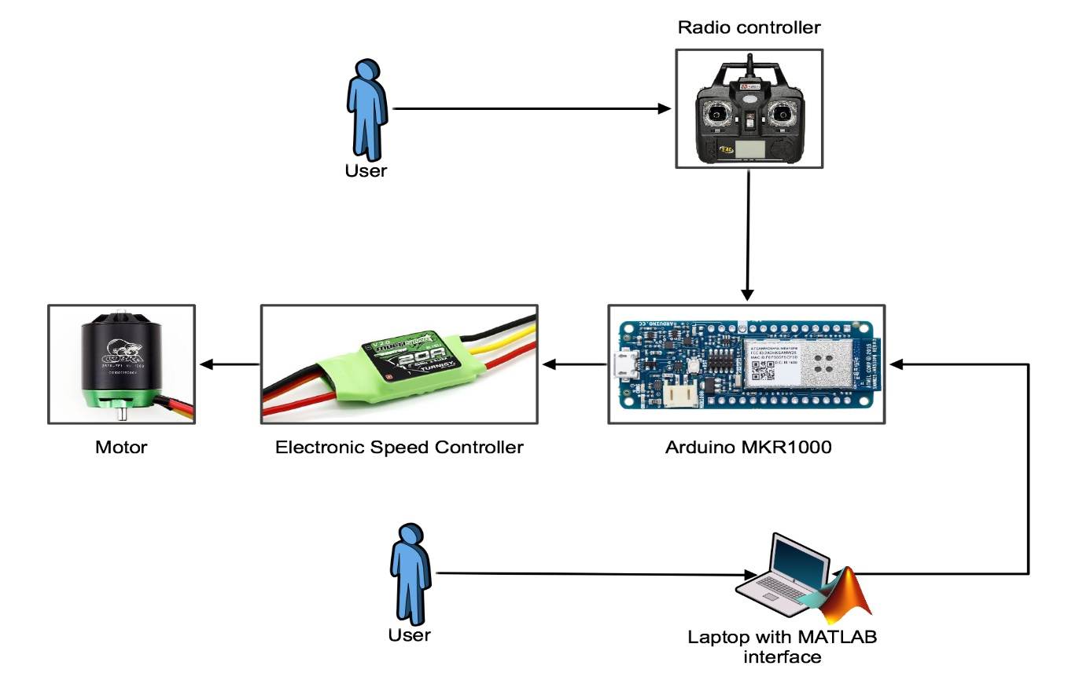
Communication schemes

Slide 15
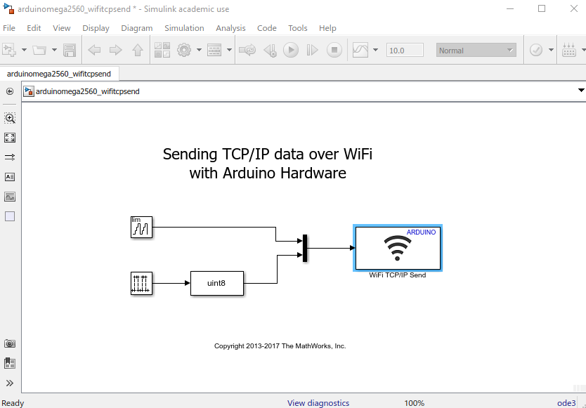
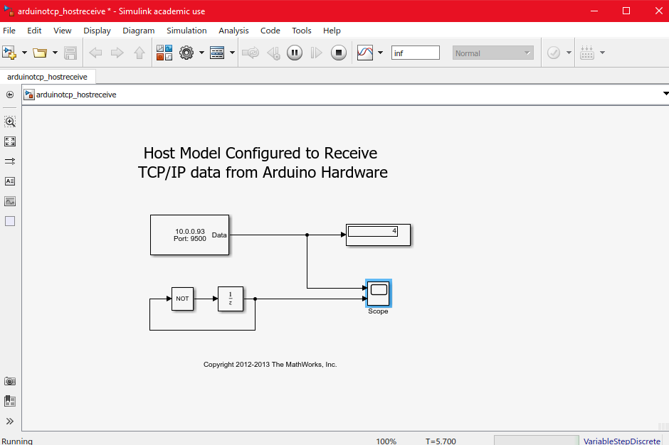
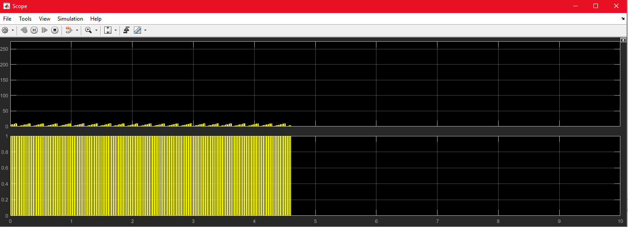
Matlab-Arduino tests
TEST #1: Sending tcp/ip data over wi-fi

Slide 16
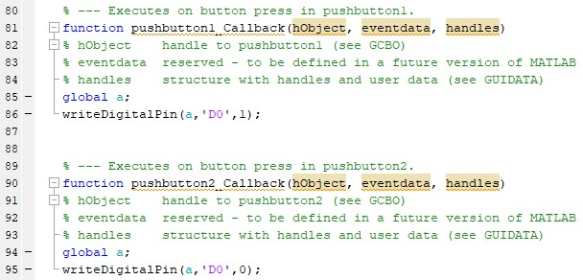
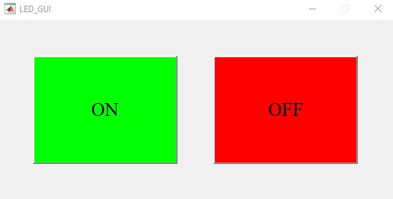
Matlab-Arduino tests
TEST #2: Turning ON LED through GUI

Slide 17
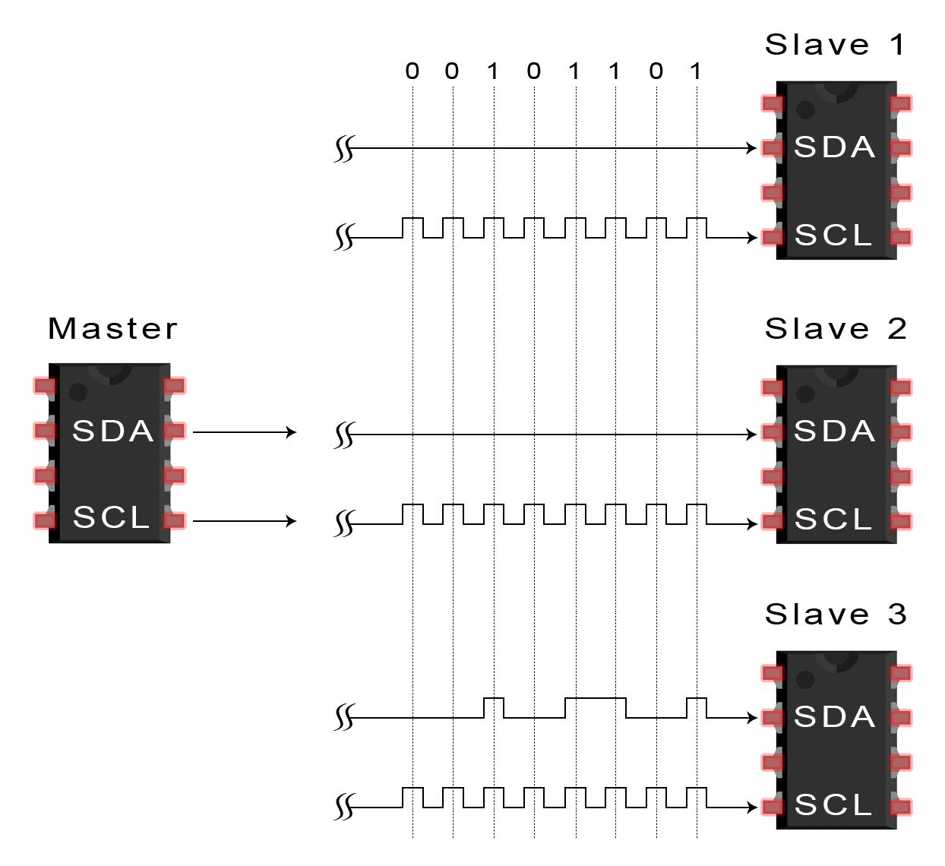
Implementing i2c
Uses two wires: SDA, SCL
Communication between master and single or multiple slave devices
Send and receive data – Reading and registers

Slide 18
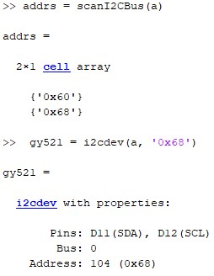
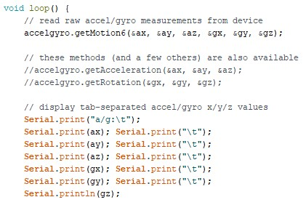
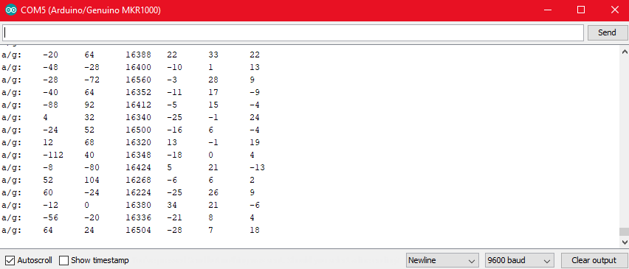
Implementing i2c

Slide 19
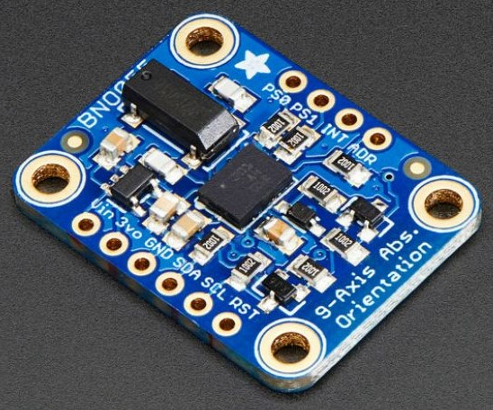
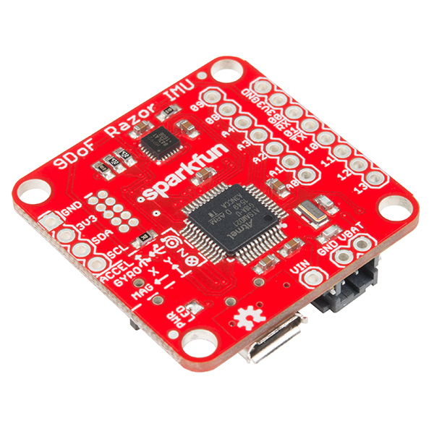
IMU substitutes
Adafruit BNO055
SparkFun Razor IMU
9-DOF
Accelerometer, Gyroscope, Magnetometer, 3 Axis

Slide 20
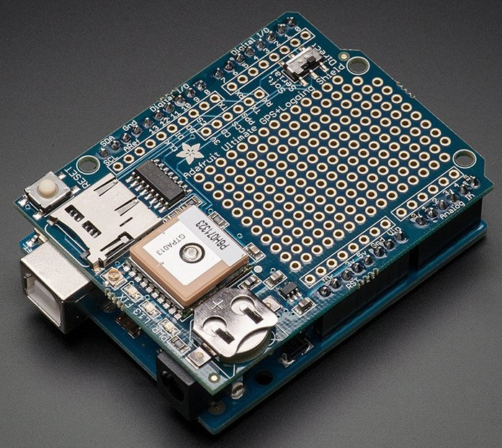
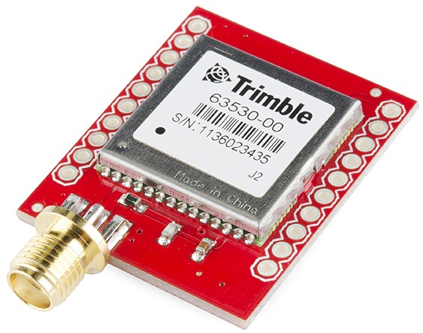
gps substitutes
Adafruit Ultimate GPS Logger Shield
SparkFun GPS Module Copernicus II DIP
-165 dBm sensitivity
10 Hz updates
66 channels
-160 dBm sensitivity
1 Hz updates
12 channels

Slide 21
Future work
Honeywell CDR
Continue communication tests
Complete modeling & simulation phase
Integrate Arduino MKR1000 with Arrieta G25, IMU, GPS, and UAV motors
Evaluate designed control system

Slide 22
Questions?

